Slide 1
Combating Ageism in the Health Care Workforce
Creating an Age Friendly Workplace
Hanley Leadership Group - XVII

Slide 2
What does ageism look like?
What is ageism?
A stereotype (how we think), prejudice (how we feel) and discrimination (how we act) towards others or ourselves based on age.
Examples of ageism in the workplace includes scenarios such as denying applicants because they’re close to retirement or giving an older employee’s responsibilities to a younger worker.

Slide 3
Ageism is driven by…
Stereotypes about older employees including being:
slow/less productive
stubborn & inflexible
inexperienced with technology & unable to adapt to new technology
According to AARP research of workers between the ages of 45 and 74, most people believe age discrimination begins when workers hit their 50's.
22 % believe it begins even earlier, when workers hit their 30's and 40's.
17% think it begins in the 60's.

Slide 4
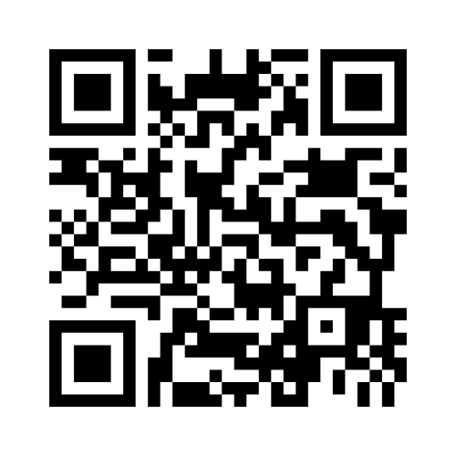
Mentimeter
Notes:
Results page: https://www.mentimeter.com/app/presentation/al53qg7i8oeein1jdafxq4sz4fuuyrz9

Slide 5
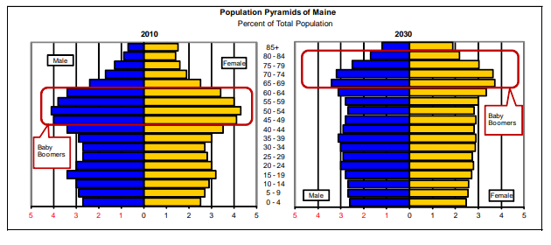
Maine’s Population is Aging
By 2023, the baby boomers will be between 66 and 84 years old. As the baby boomers continue to age, the population pyramid will become top-heavy, with a larger elderly population and smaller youth population.

Slide 6
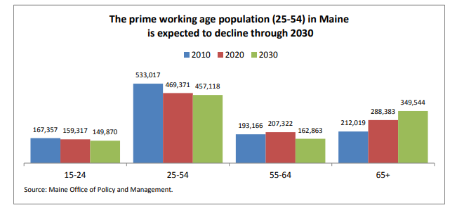

Slide 7
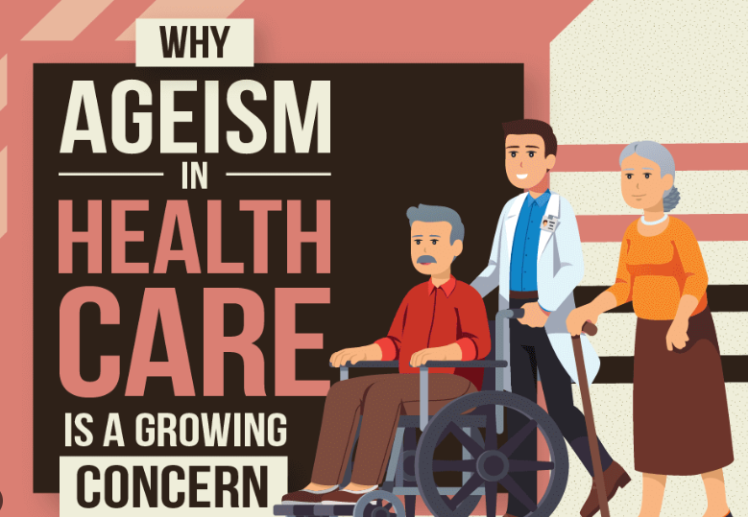
With Maine's workforce trends, we will have less workers in Maine to be able to support the growing need for healthcare support.
"We have the highest percentage of people who generally need the most healthcare, 50 and older, but the lowest percentage of people who make up the, generally speaking, the vast majority of the healthcare workforce".
- Dr. Dora Mills, MaineHealth

Slide 8
Retired OR Tech – Decided to retire secondary to no longer being able to meet the physical demands of the job, but would like to come back to the medical work force in another capacity​
Current Practice Manager - "As a member of the aging workforce I know I could certainly use something like a more flexible schedule to accommodate caretaking needs of family members, which is a common stressor among similarly aged friends and peers.”
Currently Practicing Pediatrician –
Factors such as full call schedule rotation expectations, advancing electronic medical record, RVU expectations, and increasing quality metrics are making daily practice unenjoyable and daunting – looking to retire earlier than anticipated because of these factors.
What older healthcare workers are saying...

Slide 9
Cultivating Culture - Benefits of older workers
Skill & experience
Business knowledge & networks
Stay at jobs longer
Strong work ethics
Create multi-generational workforces
Critical role in training the upcoming generations

Slide 10
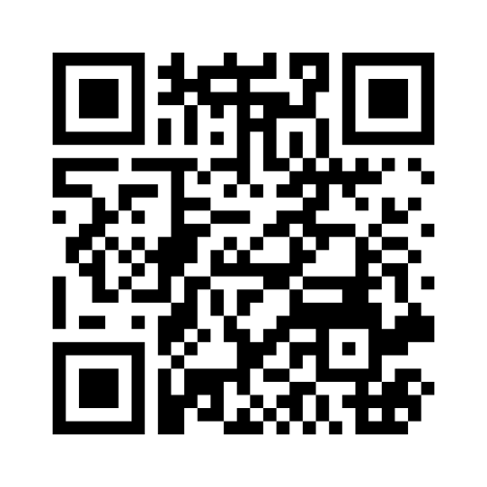
Mentimeter
Notes:
Results page: https://www.mentimeter.com/app/presentation/alb9e1csnvb1b9t4or4qi2sv35ro51wf

Slide 11
What we did...
Toolkit development
Toolkit with introductory letter explaining the situation around ageism in Maine's healthcare workforce and offering tools for employers
Toolkit distribution
Sent to hiring managers and human resource departments across the health spectrum
Feedback collection
Asked targeted questions about their experience with the toolkit

Slide 12
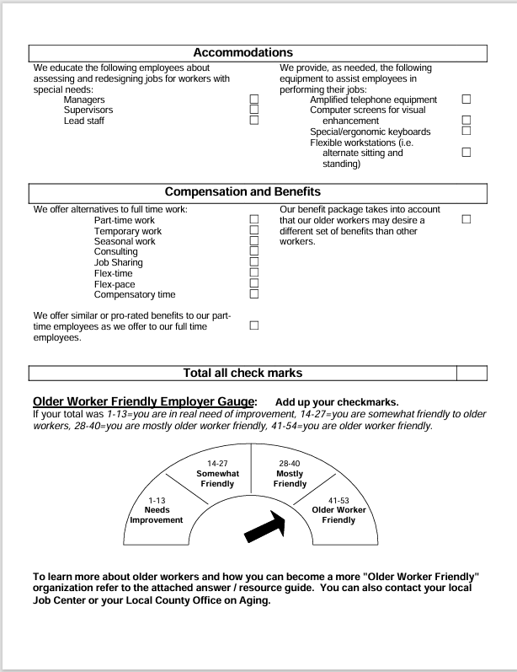

Slide 13
Toolkit Contents
Existing resources for employers on recruiting/ retaining older workers:
Centre for Ageing Better: Good Recruitment for Older Workers: A Guide for Employers
Workforce & Employment Workgroup of the Maine Aging Initiative-Key Workforce Messages for Employers
AARP-Employer Pledge to demonstrate commitment to experience workers
American Society on Aging-Age Inclusive Employers
7 Principles to Attract and Retain Older Frontline Workers
AARP-Hire an Older Worker
Generations American Society on Aging- Older Workers Are Employable-Tips for Retaining, Reintegrating, and Recruiting
Assessments:
The Center on Aging & Work: Workforce Benchmarking Tool: Online assessment for organizations that builds a customized toolkit to support hiring experienced workers.
Age-friendly Workplaces: A Self-assessment Tool for Employers: Printable assessment tool to help assess employer readiness to support older workers.
Older Worker Friendly Assessment Tool for Employers: Short printable assessment tool from the Department of Workforce Development from the State of Wisconsin.
Key places for support addressing agism in the healthcare workforce:
Maine Council on Aging
AARP-Employer Resource Center
Maine Department of Labor-Workforce Resources for Older Adults
Notes:
Highlight that this is just the beginning step of a toolkit. What would be great is if there was more time that could be dedicated to compiling all the resources by topic so that we could provide organizations with 1 assessment and 1 resource that contains the actionable steps they need to take.

Slide 14
Survey Scores
We surveyed 5 organizations and found the following:
Scores ranged low to high.
Average score: 19.2

Slide 15
Question #1 Is your organization actively addressing ageism in the workforce?
I think that we need to discuss ageism. We have people in our staff that could have signs of memory issues, and our other staff treat them horribly.
As a front-line manager I’m unaware of any efforts to train hiring managers to recognize the value of, and needs of, the aging workforce
Many having impressive longevity with the company. Benefits that support the aging workforce include, flexible scheduling, remote work, shared work, multiple work options, seasonal work, and support for retirement savings and planning.

Slide 16
Question #2 What value to your organization is a Toolkit like this?
The toolkit offers an easy and effective way to assess current state of an organization. I would love to know we are focusing on using a toolkit and even more
Generally, the tool kit was helpful to me as a Director. Some of the resources were new to me. The assessment tools were very helpful.
I think it’s super useful. People have the resources right there and don’t have to go digging to find the best ones

Slide 17
Question #3 After reviewing the Toolkit, what steps is your organization taking to address this issue?
Each year we look at our benefits package to see what is important to our employees. The older worker friendly lens would be helpful when we are looking at what benefits to offer.
I have discussed the issue with several organizational leaders. While they are somewhat interested and recognize the need to be aware of potential ageism practices, I have not seen (the agency) willing to dedicate the time to create an action plan.
I do see ageism conversation among that group but not sure if I see it across the organization. I think the organization is very interested in employee engagement and it is discussed at the Leadership conf for multiple months now by HR – but no one seems to touch upon this topic.

Slide 18
SO, WHAT NOW??

Slide 19
Our vision and next steps:
Continued outreach and education to support organizations to take actionable steps to addressing ageism
Encourage organizations to include ageism as their Diversity, Equity, and Inclusion initiatives
Keep awareness of ageism at forefront within the workforce
As Hanley leaders, work within our center of influence to support older workers

Slide 20
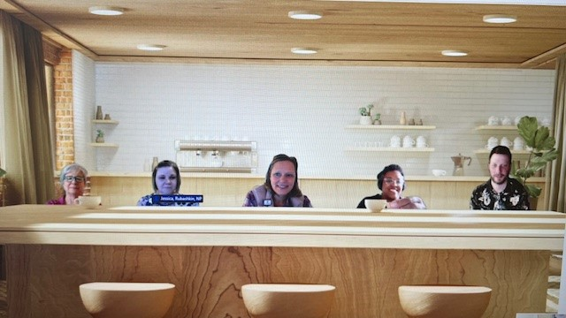
Thank You!

