Slide 1
Customizing the CME Evaluation
Maine Medical Education Trust

Slide 2
How many of you have wanted to change something about the CME evaluation in the past?
Share one thing in the chat that you wished you could have changed about the CME evaluation but felt you couldn’t.
OR
Share one thing that you did change about the CME evaluation in the past.

Slide 3
Introduction
Collecting data regarding the effectiveness of a CME activity is a required component of the CME process.
The evaluation is the most common tool used.
There is much flexibility within the evaluation to customize it to provide information that is valuable to your organization.

Slide 4
Agenda
Collecting Evaluations
Required Components
Optional and Customizable Components

Slide 5
Collecting Evaluations

Slide 6
When to Distribute Evaluations
one-session
One-day
multi-session
Multi-Day
Multi-session
Regularly scheduled series
Immediately following the activity.
After each session.
OR
Once, at the end of all sessions.
After each session.
OR
At the end of each day.
OR
Once, at the end of the last day.
After each session.

Slide 7
How Long to Collect Evaluations
You set the time frame
Shorter is better
Give learners a time-frame of when the evaluation will be closed.
Suggestion: 1-2 weeks, with a reminder.
Consider giving learners time to complete it at the activity.
Content and opinions are fresh.
A report must be submitted within 45 days after the activity.
Learners may want to see their credits sooner.
Learners are more likely to do it then if they know they have a short window to complete it.
Learners can still receive certificates and their credits can be reported if they miss the evaluation time frame.

Slide 8
Q. Must learners complete an evaluation to receive their CME Certificate?
Technically, no.
There is no requirement set by the AMA that learners must complete an evaluation to receive a certificate.
However, the MMET is required by the ACCME to collect information regarding changes learners intend to make in their practices as a result of their participation in CME activities.
If physicians participate in the activity, MMET must have completed evaluations.

Slide 9
Q. Must learners complete an evaluation to receive their CME Certificate?
Set the expectation that evaluations must be completed to receive a CME Certificate.
Then bend the rule only when necessary.
*Certain activities such as enduring materials require evaluations to ensure the completion of the activity.

Slide 10
Required Components
There are 8 required components

Slide 11
1. Activity Information
The following should be included on the evaluation:
Activity Title
Activity Date(s)
Name of Joint Provider (Your Organization)

Slide 12
2. Objectives
List the objectives
Where to put the objectives
Can include all objectives.
Can be overarching objectives for a larger activity.
Can be a sampling of objectives for a larger activity.
Can be listed at the top.
Can be listed with each presenter.
Can be listed to correspond with a particular question.

Slide 13
Example:
Listing All Session Objectives

Slide 14
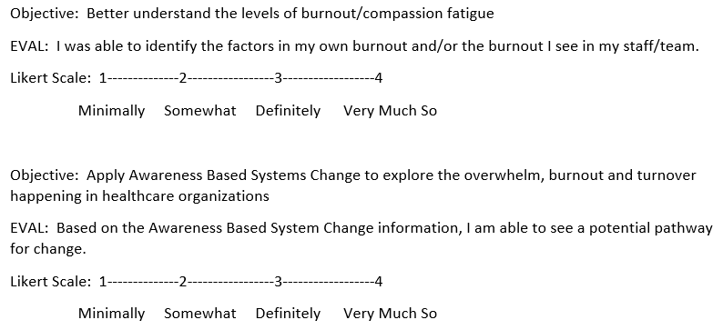
Example:
Separating Objectives

Slide 15
3. Learner Change Question
Must include at least one of the following:
Must ask for examples
Will this activity enhance your competence?
Will this activity influence your practice?
Will this activity impact your patient outcomes?
As a result of this activity, list one or two things you plan to change in your practice.
If yes, please list examples.
As a result of this activity, list one or two things you plan to change in your practice.

Slide 16
4. Faculty Disclosure Feedback
Note: This question does not need to be asked if the activity was exclusively non-clinical.
Ask learners if potential conflict of interest was provided.
This is the Disclosure to Learners based on the faculty disclosures.
Must disclose the presence and/or absence of relative financial relationships.
Must provide evidence of disclosure to learners in post-CME activity materials.

Slide 17
5. Commercial Bias
Note: This question does not need to be asked if the activity was exclusively non-clinical.
Ask the learners if they perceived any commercial bias.
Be sure to give learners the opportunity to explain the bias they perceived.

Slide 18
6. Commercial Support Disclosure
Note: This question does not need to be asked if the activity did not receive commercial support.
Ask learners if commercial support was disclosed.
Can modify the question to:
Was information regarding the commercial support for this activity provided to the audience?

Slide 19
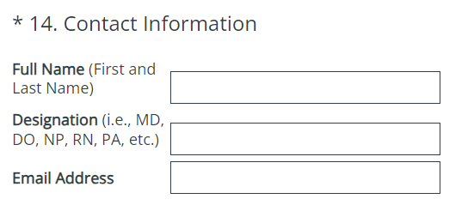
7. Collecting Learner Information
All Evaluations should collect
Name
Credentials
Contact Information
Email is sufficient

Slide 20
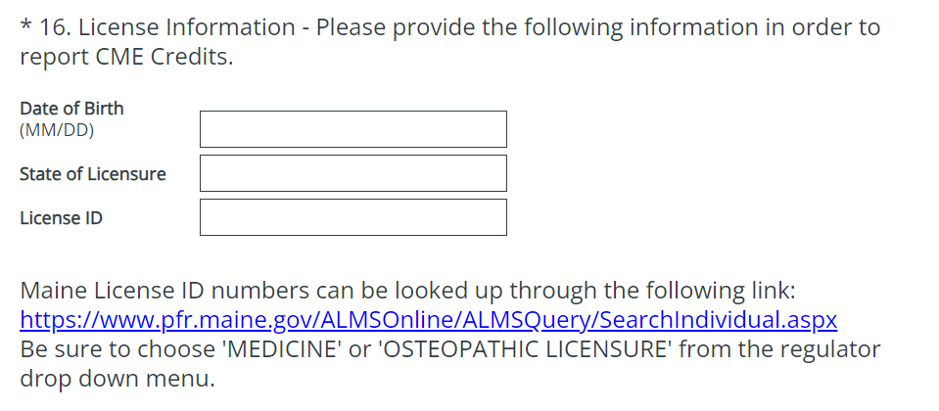
7. Collecting Learner Information
Maine-Based activities should collect:
Consent to report credits to Maine State Boards
Date of Birth (MM/DD)
State of Licensure
License ID
*Can report for any state

Slide 21
7. Collecting Learner Information
For other states:
Can choose to collect and submit this information
Change the Board of Licensures to reflect your organization’s state

Slide 22
7. Collecting Learner Information
For all states:
Modified consent question on Generic Evaluation Form

Slide 23
8. Statements
AMA Credit Designation Statement
Joint Providership statement
The Maine Medical Education Trust designates this [activity type] for a maximum of [number of credits] AMA PRA Category 1 Credit(s)TM. Physicians should only claim credit commensurate with the extent of their participation in the activity.
This activity has been planned and implemented in accordance with the accreditation requirements and policies of the Accreditation Council for Continuing Medical Education (ACCME) through the joint providership of the Maine Medical Education Trust and [name of nonaccredited provider]. The Maine Medical Education Trust is accredited by the Maine Medical Association Committee on Continuing Medical Education and Accreditation to provide continuing medical education for physicians.
Statements can be placed at the top or bottom of the evaluation.
Opioid prescribing education
Only if offering opioid prescribing education credit.
This activity qualifies for [number of credits] credit(s) of the 3 CME credit requirement for opioid medication education found in P.L. 2015, Chapter 488, Maine’s legislation to address the opioid drug crisis.

Slide 24
Summary of Required Components
Activity Information
Learning Objectives
Learner Change Question
Faculty Disclosure Feedback
Commercial Bias Question
Commercial Support Disclosure Feedback
Learner Information Questions
Statements

Slide 25
Optional and Customizable Components

Slide 26
Optional/Customizable Components
Venue Feedback
Speaker Feedback
Suggestions
Format

Slide 27
Venue
If you could change anything about this feedback, what would you change?
On generic form:

Slide 28
Venue
How could you change this?
Customize the categories
Change the scale
Ask more specific questions
Customize for virtual activities

Slide 29
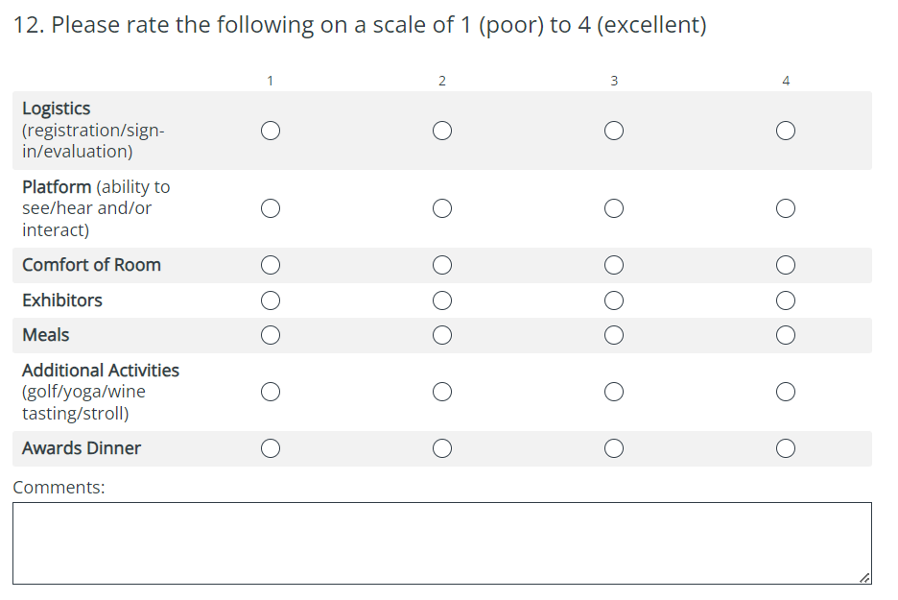
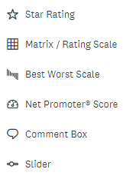

Slide 30
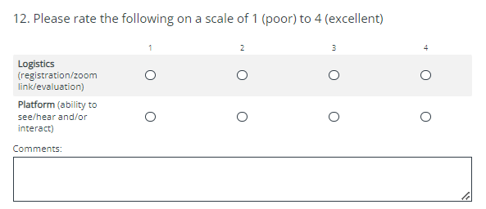

Slide 31
Speaker Feedback
If you could change anything about this feedback, what would you change?
On generic form:

Slide 32
Speaker Feedback
How could you change this?
Customize the categories
Change the scale
Include all/some/none of the speakers
Base feedback on session(s) attended

Slide 34
Suggestions
It is optional to ask learners to provide suggestions or topics for future programs.
Could have learners rate given topics from highest interest to least interest.

Slide 35
Format
Keep in Mind:
- You must submit a copy of the evaluation with Activity Application Materials. The evaluation submitted must be in the format that will be used in the activity.
How many of you use digital evaluations or paper evaluations?
ANSWER IN THE POLL
Choice is yours:
Digital
OR
Paper
Keep in Mind:
- You will need to provide either an evaluation summary or copies of all the completed evaluations with Post-CME Activity Materials.
Things to Consider:
What is easiest for your learners?
What might get more responses?
What is easiest for you?

Slide 36
Summary
All activities should collect some standard information.
Customize the parts of the evaluation that are specific to your activity.
Collect data that will be meaningful to your organization.

Slide 37
Thank You
Next Session:
Commercial Support in Accredited Continuing Education
Thursday, October 5th
9-10:00am
Zoom Invitation to be sent
Elizabeth Ciccarelli
eciccarelli@mainemed.com

